Slide 1


Titolo presentazione sottotitolo
HW1 – Sound Classification
Milano, XX mese 20XX

Slide 2
Index
Audio effects classification – Introduction
Feature choice
First attempt
Final attempt
Dataset selection
Multi-class Weighted Support Vector Machine
Results

Slide 3
Audio effects classification - Introduction
ASSIGNMENT:
implement a classifier system able to predict the audio effect (between tremolo, distortion and noFX) used in recordings of electric guitar and bass.
IMPLEMENTATION:
Support Vector Machine with majority voting for multiclass classification.

Slide 4
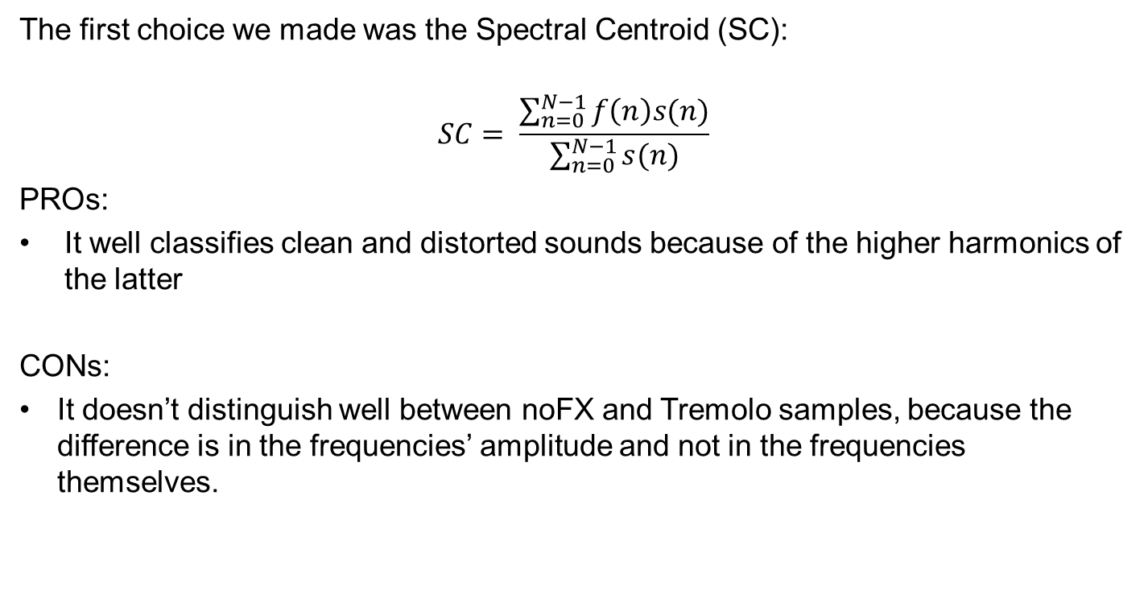
Feature choice – First attempt
The first choice we made was the Spectral Centroid (SC):
$$SC= \frac{\sum_{n=0}^{N−1}{f\left(n\right)s(n)}}{\sum_{n=0}^{N−1}{s(n)}}$$
PROs:
It well classifies clean and distorted sounds because of the higher harmonics of the latter
CONs:
It doesn’t distinguish well between noFX and Tremolo samples, because the difference is in the frequencies’ amplitude and not in the frequencies themselves.

Slide 5

Feature choice – Final attempt
Then we opted for the Root Mean Square (RMS):
$$RMS=\sqrt{\frac{1}{N}\sum_{n}{{\left|x(n)\right|}^{2}}}$$
It conveys precisely the characteristics of the effects with respect to the decay.

Slide 6
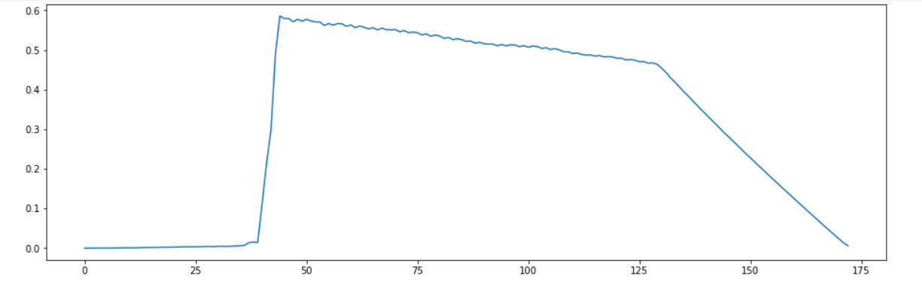
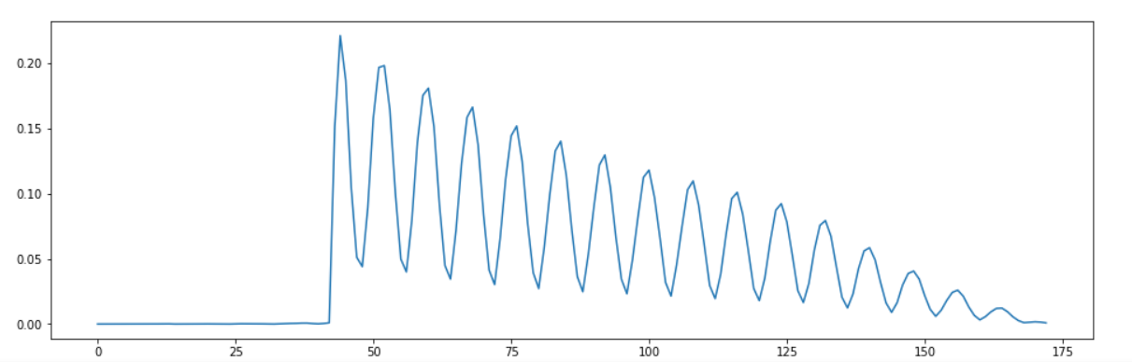
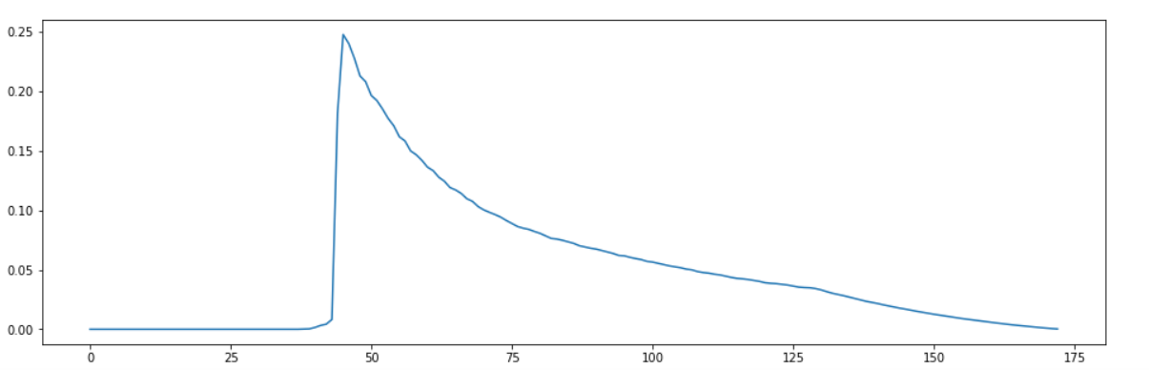
Feature choice – Final attempt
Distortion
Tremolo
noFX

Slide 7
Dataset selection
We use only monophonic bass and guitar tracks.
More homogeneous magnitude frequency spectrum
Increase the classification precision.
 | Train (# elements) | Test (# elements)
Distortion | 1394 | 1238
Tremolo | 1194 | 1228
NoFX | 559 | 555
We divided the whole dataset in about half for the training and the test sets.

Slide 8
Multi-class Weighted Support Vector Machine
Unbalanced training set
By default the SVM suppose to work with balanced training-set, each class has the same global Weighting factor called C, used in the calculation of the margins when fitting the SVM Model.
We implemented weighted SVM model setting efficiently an internal private variable that define a custom weighting-factor proportional to the class distribution allow to have an accurate penalty term C for each class.
Minority class
Larger weighting factor
More flexibility with misclassified tracks.
Multi class implementation
SVMs are binary classifier. In order to manage 3 classes during the training stage we applied three SVM, one for each couple of class: Distortion/Tremolo, Distortion/NoFX and Tremolo/NoFX.
Applying majority voting during the testing stage , we are able to select correctly every track of each class.

Slide 9
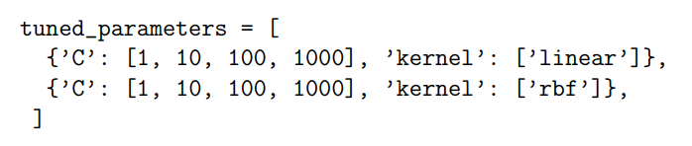
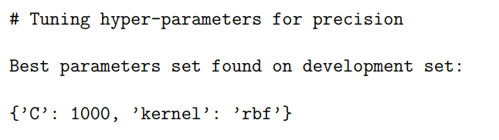
Cross-validation
GridSearchCV from scikit-learns
Tremolo vs NoFX
Score functions: recall and precision
High C

Slide 10
Results
Confusion matrix:
RMS | Distortion | Tremolo | NoFX
Distortion | 1219 | 19 | 0
Tremolo | 4 | 1224 | 0
NoFX | 7 | 1 | 547

